Slide 1

Sentence Construction

Slide 2

Conjunctions – join words together

Slide 3

Why do we need them?
Conjunctions help us maintain a strong flow in written and verbal communication.
Used correctly, conjunctions help create better sentences; they create a natural flow and rhythm to your speech or writing. Using them incorrectly, results in disjointed or incoherent communication.

Slide 4

How do we use them?
For example:
‘ I hate curry.’ is a simple sentence. ‘I like Thai food.’ is also a simple sentence.
Put these together to make one longer and more interesting compound sentence using a conjunction:
‘I hate curry but I like Thai food.’

Slide 5
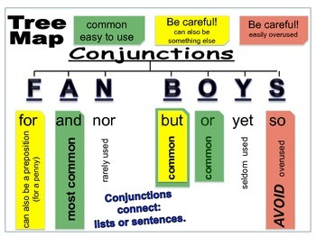
Coordinating Conjunctions
Coordinating conjunctions are the most common form of conjunctions. They are used in nearly every sentence or paragraph in some form or another. Despite the frequency of these conjunctions, their use still results in common mistakes. There are seven coordinating conjunctions in total: FANBOYS.
Often, two sentences can be grammatically correct separate, but sound strange and stilted, especially when there are a lot of them.

Slide 6

Beware! Conjunctions may change the meaning of the sentence.
Conjunctions don’t just stick sentences together they show the relationship between the pieces of information. For example, note the slightly different meaning in these sentences:
I walked home. I was tired.
I walked home and I was tired.
I walked home as I was tired.
I walked home but I was tired.
I walked home so I was tired.

Slide 7

In Academic work, avoid starting sentences with a conjunction.
Although it is sometimes done to start a sentence with a conjunction such as but, so, and, there are ALWAYS better alternatives.
Look in the file «Starting Sentences» and find alternatives.
For example:
And = In addition, ……. Consequently,…
So = Therefore, …. As a result ……
But = However, ….. Nevertheless, …..Conversely, …………..
(Note the comma)

Slide 8


Some sentences are wrong if you don’t use a conjunction.
Students often take short-cuts and either write short, stilted sentences, or even just use a comma. For example:
The dinner was burned. She had forgotten it. x
The dinner was burned, she had forgotten it. x
The dinner was burned because she had forgotten it.

Slide 9
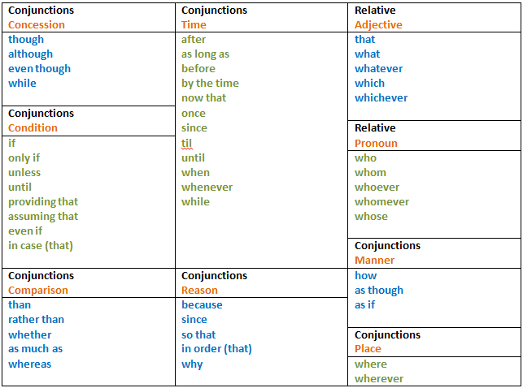
There are many categories of these types of sentence where you MUST have a conjunction for your sentence to make sense. For example: You cannot leave, because I will be unhappy.

Slide 10
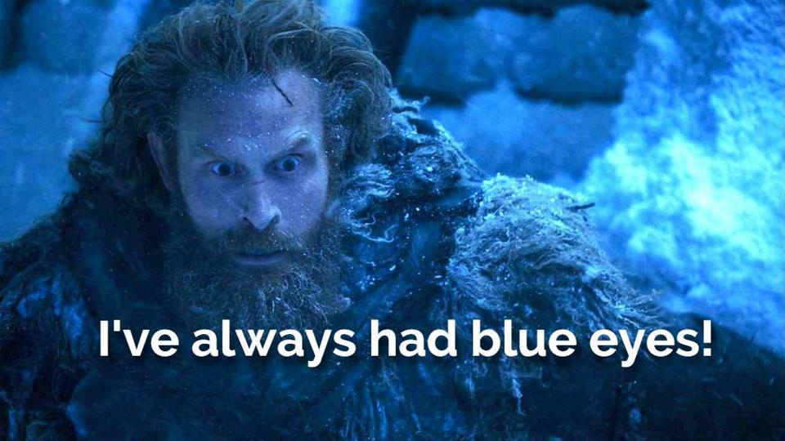
Examples
You cannot watch Game of Thrones.
You can if you have Netflix.
You cannot watch Game of Thrones unless you have Netflix.
Task: Write a few sentences using unfamiliar conjunctions from the previous page.
You can borrow my car.
Do you have a driving licence?
You can borrow my car providing you have a driving licence.

Slide 11
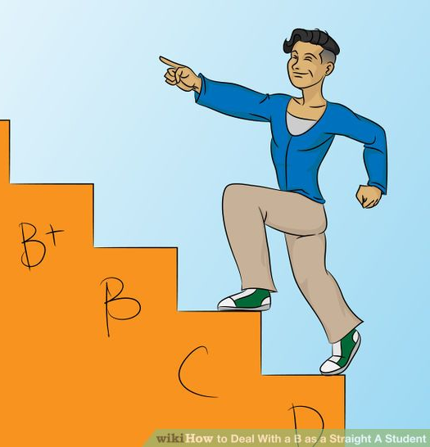
Cont ….. Subordinating Conjunctions
Subordinating Conjunctions are used to create complex sentences. A subordinating conjunction does not need to be separated from the rest of the sentence by a comma. They can be used at the start of a sentence, or in the middle. When a subordinating conjunction is used at the start of a sentence its meaning (or strength) is emphasized. When the conjunction is used in the middle of a sentence its meaning is weaker.
Examples:
Although we all know smoking is bad for our health, many people still smoke.
Many people still smoke despite knowing smoking is bad for their health.
They went out for a walk despite the cold wind.
Despite the cold wind, they went out for a walk.
The students passed their exams because they had studied hard.
Because the students had studied hard, they passed their exams easily.

Slide 12
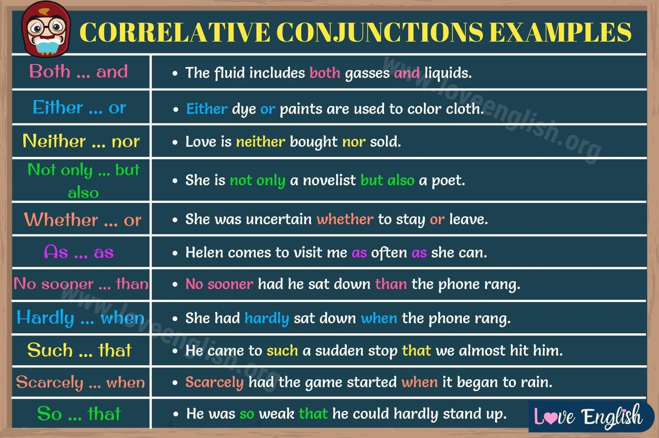
Correlative conjunctions: these are pairs of conjunctions
Task: Write a few sentences using unfamiliar conjunctions from the chart.

Slide 13
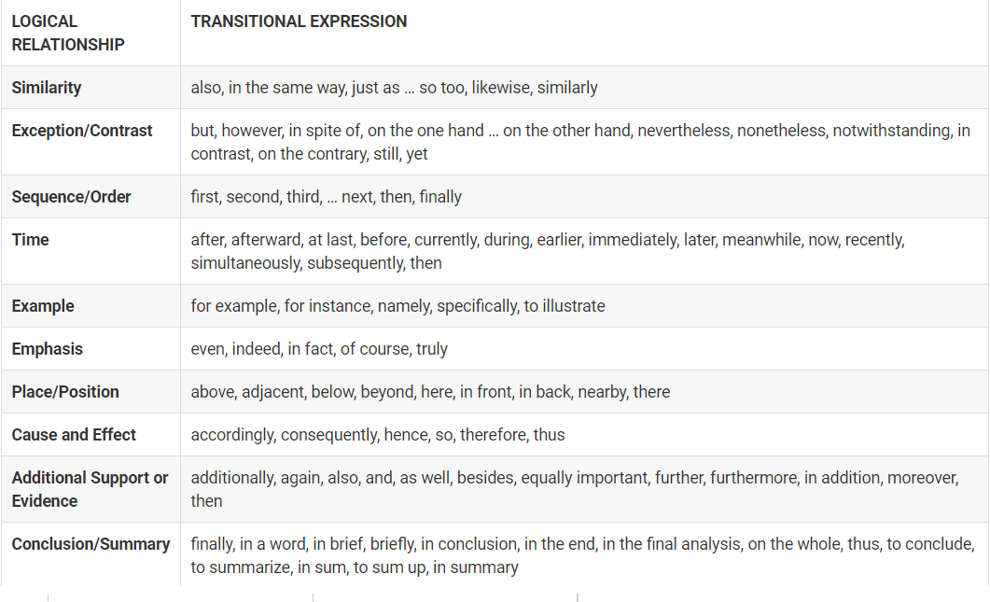
Transitions – join sentences and paragraphs, rather than clauses within a sentence.

Slide 14
Exercises
https://www.ego4u.com/en/cram-up/grammar/word-order/exercises?04
https://www.gingersoftware.com/content/grammar-rules/conjunctions/conjunction-exercises/
https://www.englisch-hilfen.de/en/exercises/word_order/conjunctions2.htm
https://www.myenglishpages.com/site_php_files/grammar-exercise-conjunctions.php
https://agendaweb.org/grammar/conjunctions-exercises.html
https://agendaweb.org/grammar/conjunctions.html
https://www.grammar-quizzes.com/8-7.html
https://www.grammarbank.com/conjunctions-quiz.html

